Slide 1
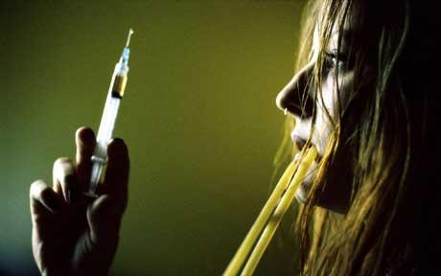
White-Comiskey Model
Bri Miskovitz

Slide 2
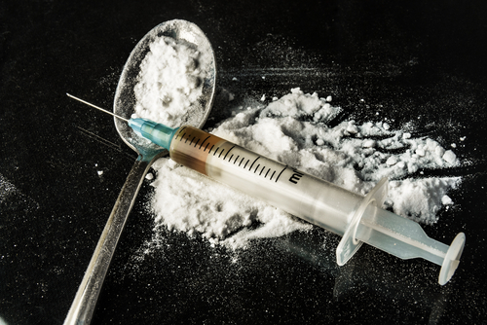
Original Model is a 3D SIR Heroin Epidemic Model
dS|dt = Λ - [β_1U_1S]/N - μS
(dU_1)| dt =
[β_1U_1D]/N - pU_1 + [βU_1U_2]/N - (μ + δ_1)U_1
(dU_2)|dt = pU_1 - [ βU_1U_2 ]/N - (μ + δ_1)U_2

Slide 3
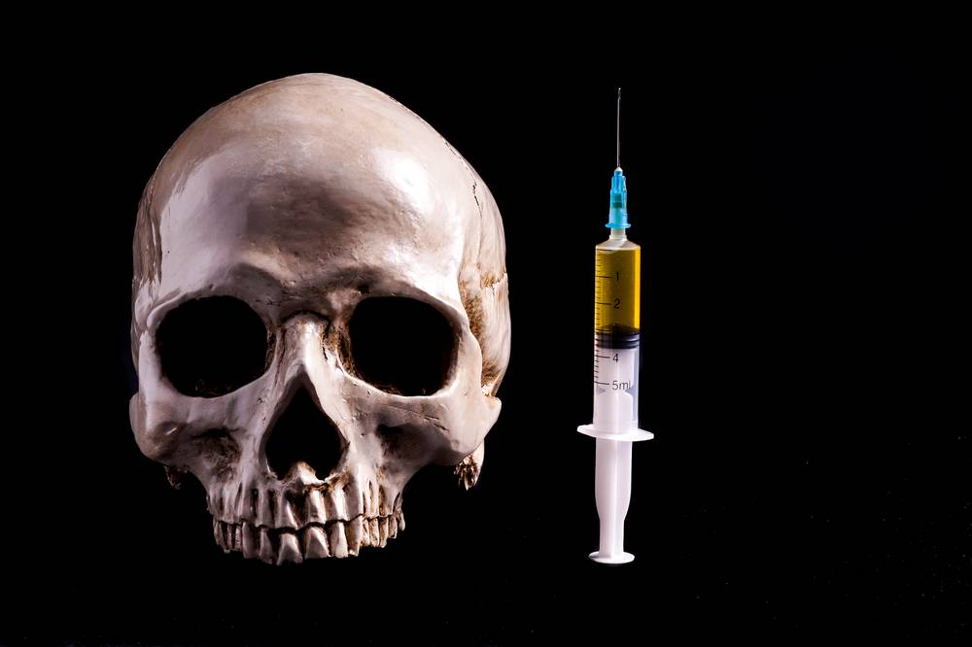
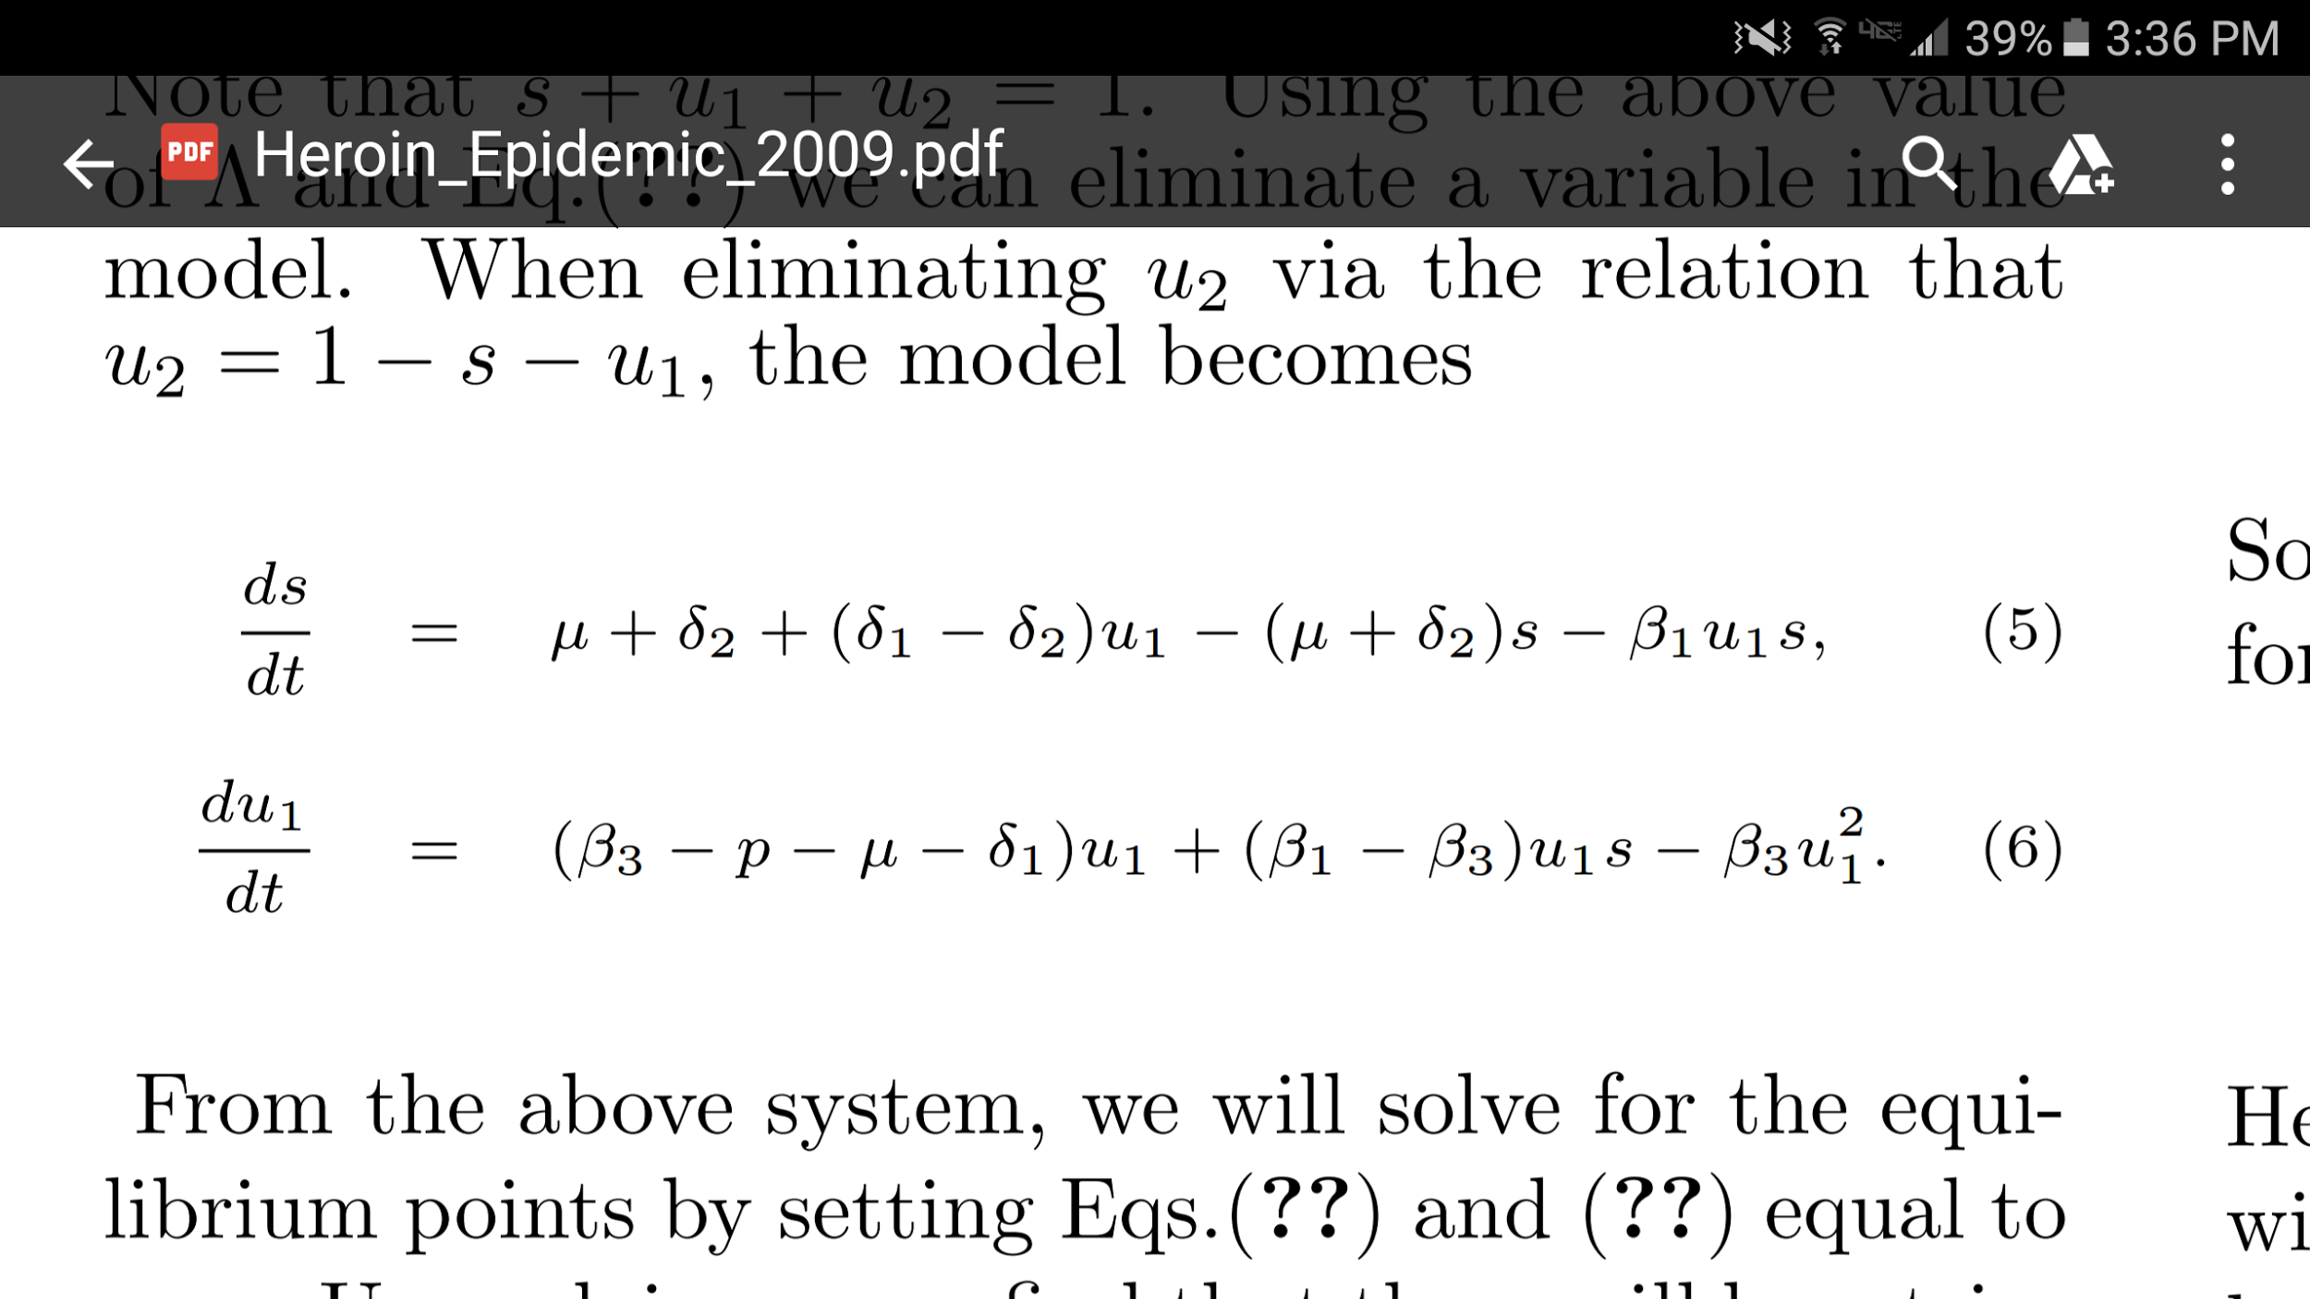
Simplified 2D Epidemic Model
Non-dimensionalized:
u_1 = U_1/N s =S/N

Slide 4
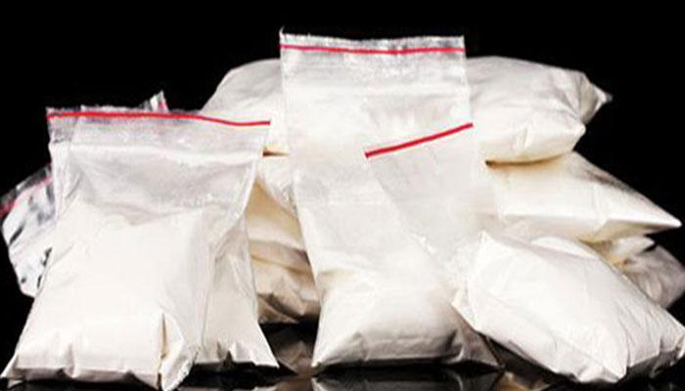
S= Susceptibles U_1 = Drug Users
μ: natural death rate of general population
δ_1: Removal/Death δ_2: Removal/Death Rate for.
Rate for Drug User Drug Users seeking treatment
β_1: Probabiliy of β_3: Probability that a drug
becoming a drug user user in treatment relapses
p : proportion of drug users who enter treatment per time
N: total population
Λ: Number of individuals that enter susceptible population

Slide 5
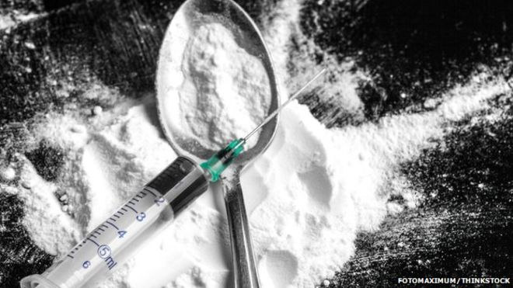
Epidemic Model
S
U_1
pU_1
U_2
Λ
[β_1*S*U_1]/N
[β_3*U_2*U_1]/N
μS
(μ + δ_1)U_1
(μ + δ_2)U_2

Slide 6
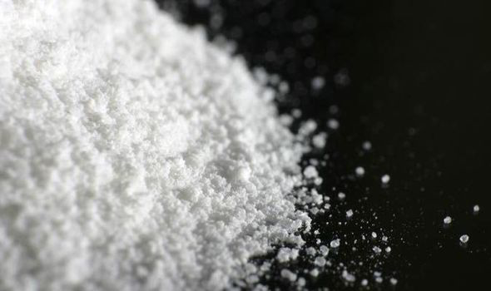
Collections of Parameters
B = β_3 - β_1
** Difference of Probabilities between becoming a drug and drug users in treatment relapsing
D = δ_2 - δ_1
** Difference of Removal/Death rates between drug users seeking treatment and drug users
ω= β_3 - p - μ - δ_1

Slide 7

Equilibrium Points
u*_1,2 = (β_1ω+B±√[(β_1+ω)^2+4β_1D(ωD+B)]
s*_1,2 = [u*_1,2]/[2β_1B]
(s*,u*) = (1,0)

Slide 8
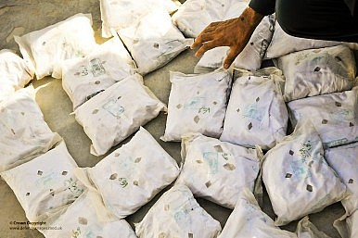
_Nullclines_
s- Nullcline: u-Nullcines:
u = [(μ+δ)(1-s)] u = [ω - β_3*u] [D + β_1*s] B
u = 0

Slide 9
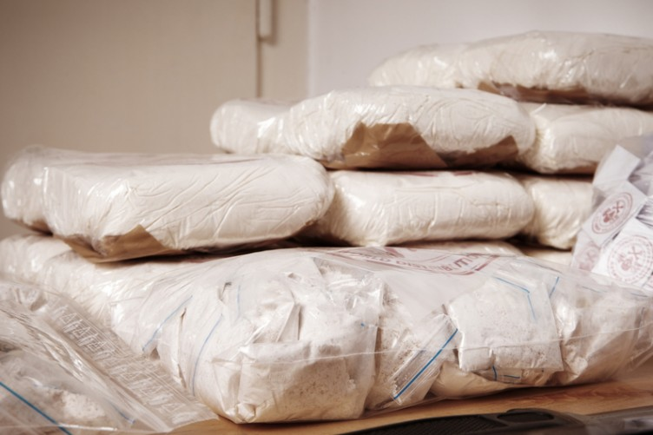
Stability Analysis @ (1,0)
**In order for the fixed to be
stable, this must be true:
β_1 < δ_1 + p + μ

Slide 10
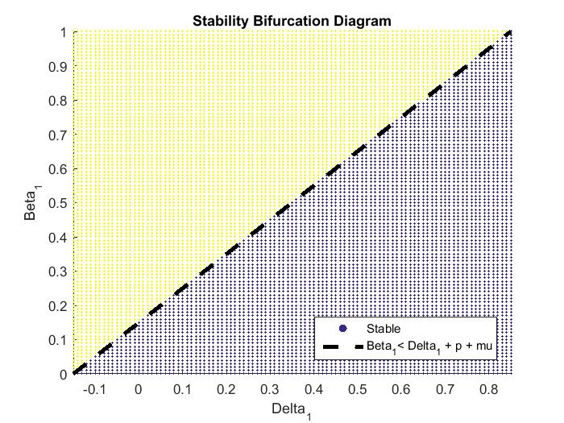
Bifurcation Stability Diagram
λ_1 = -(μ+δ_2) < 0
** Always Negative
λ_2 = β_1 - p - μ - δ_1
**Depend on parameters
β_1
δ_1

Slide 11
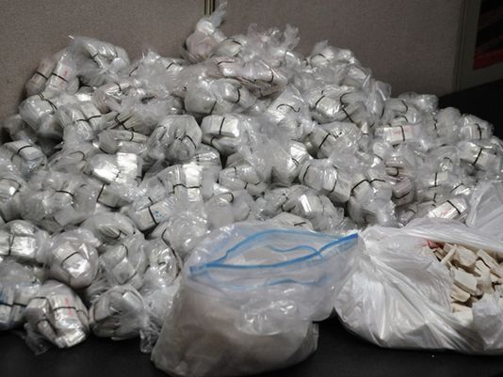
Values Used from Study:
μ = 0.05 p = 0.1 δ_2 = 0.05
β_1 = 0.2 β_3 = 0.8
Unstable: Stable:
δ_1 = 0.01 δ_1 = 0.2

